Slide 1

Team Rahi - INITIAL DESIGN CONCEPT
Atharva Shirsath
Bhavin Yardi

Slide 2
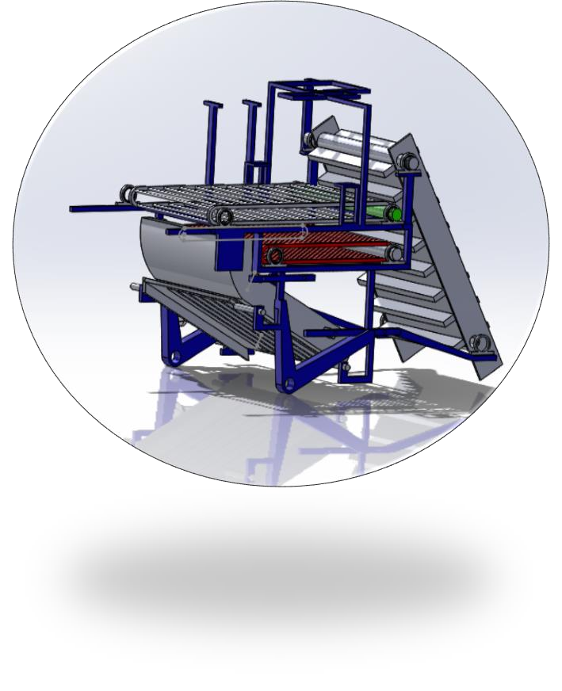


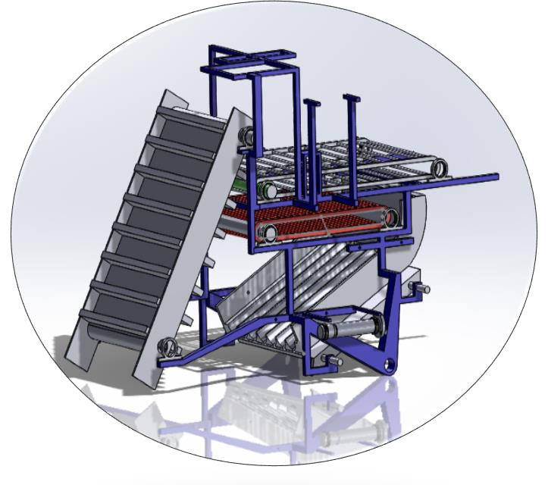

bhbddj
Contest Theme
Product For Rural Entrepreneurship
Product Name
Onion Harvesting Machine

Slide 3


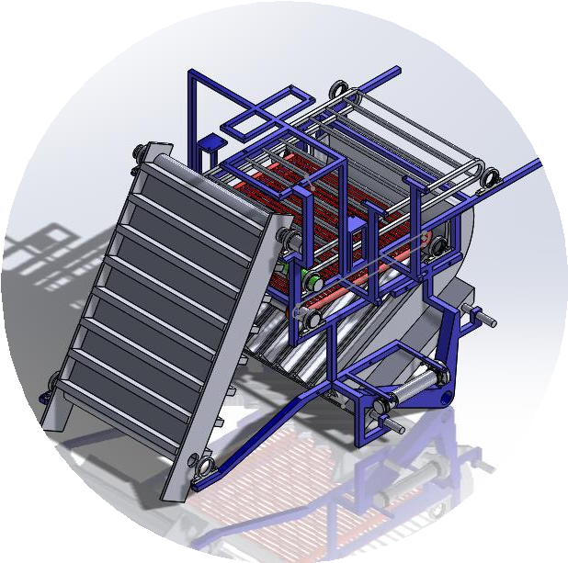
Problem Statement
Onions are the quintessential necessity of every household in every country. And, in India, not only it’s consumption, but its export is also of utmost importance. Annual turnover of Indian onion market is enormously high. In the current times, topping, the operation of harvesting to remove leaves and roots is processed by hand labor. High cost and high length of time required to process these onions add to the list of disadvantages of this operation. In addition to these, it is also becoming extremely difficult to find labor for this job. And what more, the labor that is available is so unskilled, that a fair proportion of the onions that are hand topped with this labor are non- uniform and many are damaged to the extent of being unmarketable. And, to a country that ranks 2nd in the global onion production, these problems are unacceptable. Thus, the need calls for an efficient, low cost and compact machine to help India further strengthen its control over the onion market.

Slide 4
Existing Solutions
US2531379A Harvester for onions and the like(1945) - Is largely concerned with picking them from at or near the Surface of the ground, cleaning them, separating weeds and placing them in a suitable receptacle, such as a bag or crate.
US3451485A Onion harvesting machine (1966) - having belt to convey onion to a height and placing then on table having rolls which helps to cut leaves of onion.
WO2020053841A1 Onion harvesting machine with ability to cut stems (2018)- This invention is called an onion harvesting machine with the capability of cutting stems and separating clods and stones. This machine is attached to tractor and carried the power of this machine is supplied by PTO tractor.
There are several other patents on onion harvesting. In general the present onion harvesting machines consists of conveyer belt and cutting of leaves using rotating unit like gear, razor, rolls, etc. in common.

Slide 5
Concept Idea of our product
A combination of belts and rollers driven by the PTO is used for the transportation of onions across the machine. For further movement gravity has been used as a source of force to the onions. The vibration of the tractor is utilized for breaking down the soil. A series of rollers and separator is used for the separation of soil from the onions. Slider-Crank Mechanism (also driven by the PTO) is used for the cutting of leaves. The piston of the mechanism serves as a shear cutter (has blades attached to it) for the cutting. A convergent- divergent structure is used for separating the cut leaves from the onions.
Why is our product better?
Introduction of slider crank mechanism which involves a number of plane blades attached to single crank instead of the conventional gear mechanism for cutting of leaves improves the mechanical efficiency, reduces the cost and also reduces the manufacturing complexity of the component.
Use of the harvested space of the farm to systematically lay down the separated onions and leaves.
Single machine which can independently and separately carry out the harvesting of onions and cutting of leaves which incorporates a provision for Curing of onions.
The product incorporates an efficient way for the disposal of big lumps of soil.

Slide 6
Working Principle
Harvesting
The digger enters into the soil and Plucks the onion out of it.
The onions along with the soil travels up through the conveyer belt and is dropped on the 1st roller.
The 1st roller has bars separated by a distance of 20cm which allows all onions to fall through them onto the 2nd roller and retaining the big lumps of soil on it which are thrown away at the end.
The 2nd roller has bars separated by a distance of 3cm which doesn’t allow any onion to fall through them, but does the work of separating fine particles of soil from the onions. The onions then advance to the separator attached at the end of the roller.
The onions slide down the separator under the influence of gravity. The vibration of the tractor breaks down the soil which are then thrown by the grooves in the separators. This further helps in the separation of soil from the onions. The separated soil is then thrown away.
The onions are finally dropped on the ground with soil separated and thus can be collected from there and stored for some days before cutting the leaves for the curing to take place.
Cutting of Leaves
The harvested onions are now directly placed on the conveyer belt and travel till the separator in the same way as mentioned in Step 2,3 & 4 of part 1.
In the separator, the onions keep on changing their orientation because of the vibration and when the achieve the proper orientation the leaves will be cut by the reciprocating blades. And, during this process, the onions will also continue moving down.
The onions that are separated from the leaves will go through the convergent path and will be placed in the center of the patch.
The cut leaves will go through the divergent path and will be placed around the onions. Thus, ensuring a proper separation of the two and sufficient comfort and ease in collecting the onions.

